Slide 1
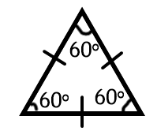
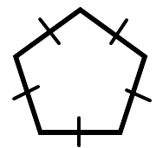

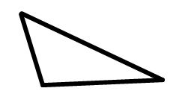


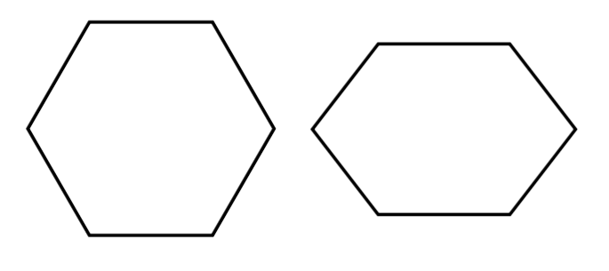
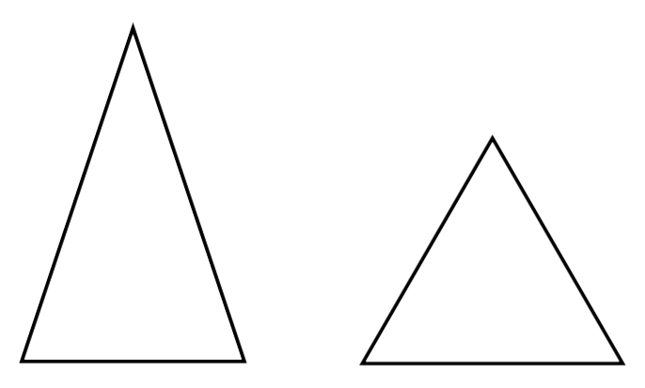
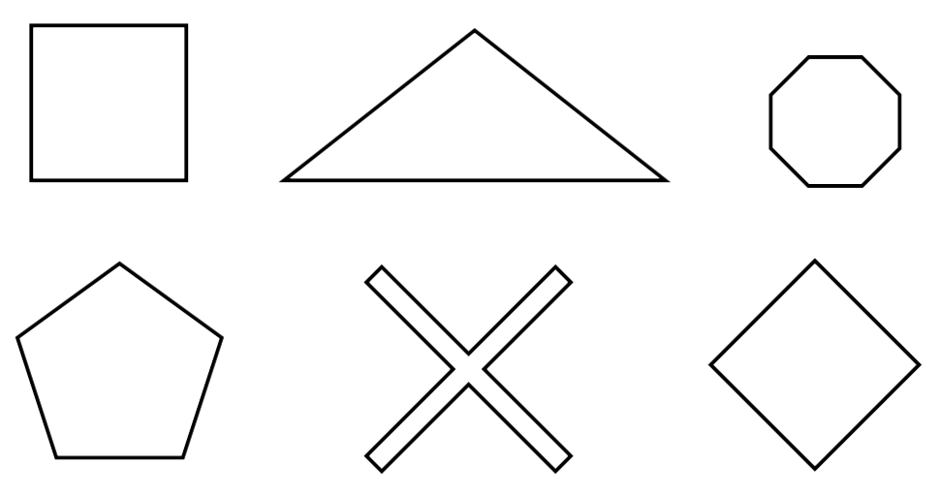
Subtopic N2.10 – Perimeter of Regular Polygons
LEARNING OUTCOME: to solve problems involving the perimeter of regular polygons
Keywords:
Distance
Regular
Polygon
Edges
Length
Units
Objectives:
To recognise a regular polygon
To find the perimeter of a regular polygon
To find missing lengths in a regular polygon
Introduction – Read and annotate:
A regular polygon is different from an irregular one because all its sides and angles are equal. To
find the perimeter of a regular polygon, you can make the calculation quicker and efficient by
multiplying the length of one side by the total number of sides, since all sides are equal in length.
If we know the length of one side of a regular polygon, we can find the perimeter, which is the total distance around the outside.
Definition
Characteristics
A polygon with all sides the same length and all angles equal
Examples
Regular Polygons
Non - Examples
Identify regular polygons
Example 1 - I do…
Example 2 – We do…
Example 3 – You do…
Steps | Tick the regular polygon: | Tick the regular polygon: | Tick the regular polygon:
1. Check whether all sides are equal 2. Check whether all angles are equal
Independent Practice
2. Fill in the gaps: A regular 4-sided shape is called a ____________.
A regular 3-sided shape is an ____________ triangle.
Tick the regular polygons
square
equilateral

Slide 2
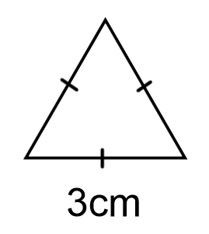
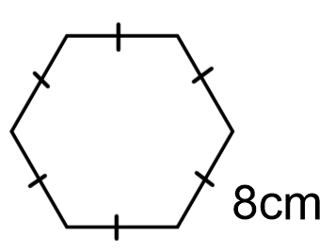
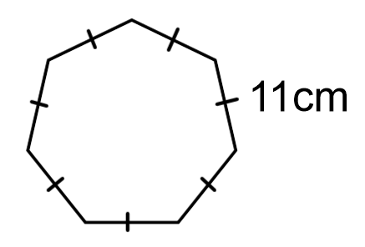
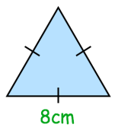
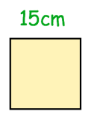
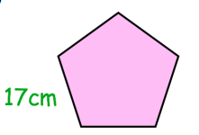
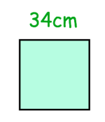
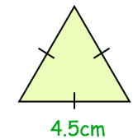
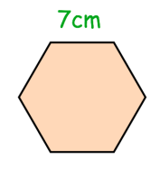
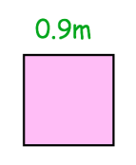
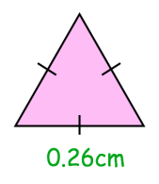
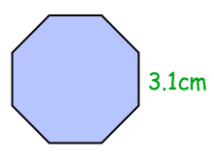
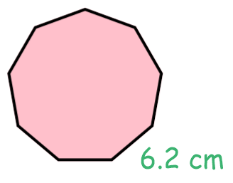
Example 4 - I do…
Example 5 – We do…
Example 6 – You do…
Steps | Find the perimeter of the regular shape below: | Find the perimeter of the regular shape below: | Find the perimeter of the regular shape below:
1. Identify the number of sides the shape has
2. Find the perimeter by adding
9cm
48cm
77cm
Independent Practice
3. Each shape below is a regular polygon Find the perimeter of each shape:
a) b)
c) d)
e) f)
g) h)
i) j)
4. a) A equilateral triangle has side length 2.8 m. What is its perimeter?
b) A regular pentagon has side length 7.38 cm. What is its perimeter?
24cm
60cm
85cm
136cm
13.5cm
42cm
3.6m
0.78cm
24.8cm
55.8cm
8.4m
36.9cm

Slide 3
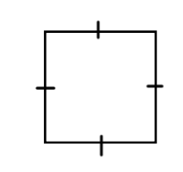
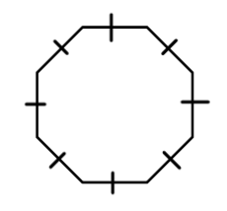
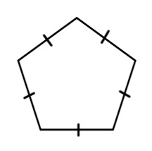
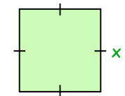
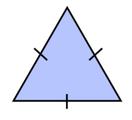
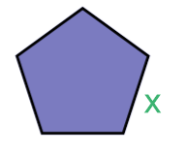
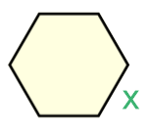
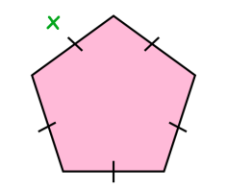
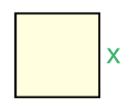
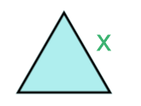
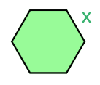
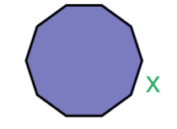
Example 7 - I do…
Example 8 – We do…
Example 9 – You do…
Steps | Given the perimeter of the shape below, find the side lengths. | Given the perimeter of the shape below, find the side lengths. | Given the perimeter of the shape below, find the side lengths.
1. Count the number of sides | Perimeter = 12 cm | Perimeter = 160cm | Perimeter = 45 cm
2. Work out the side length to give this perimeter
3cm
20cm
9cm
Independent Practice
5. Each shape below is a regular polygon.
Given the perimeter of each shape, find its side lengths.
a) Perimeter = 20 cm b) Perimeter = 18 cm
c) Perimeter = 500 cm d) Perimeter = 48 m
e) Perimeter = 20 m f) Perimeter = 240 cm
g) Perimeter = 240 cm h) Perimeter = 240 cm
i) Perimeter = 180 m j) Perimeter = 2.7 m
5cm
6cm
100cm
8m
4m
60cm
80cm
30cm
30m
0.27m

Slide 4
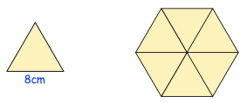
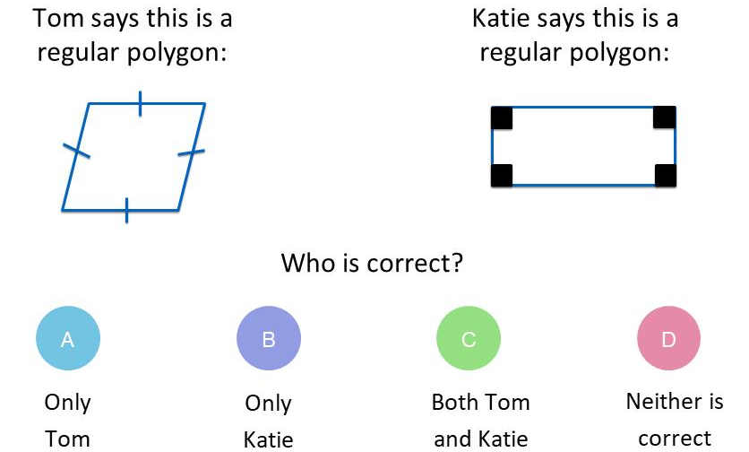
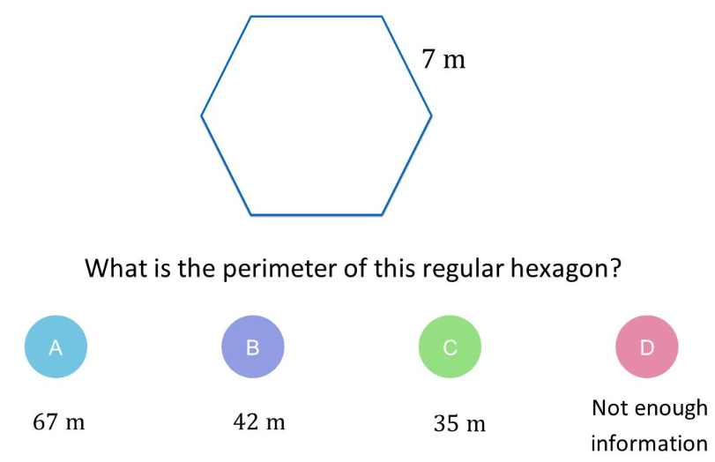
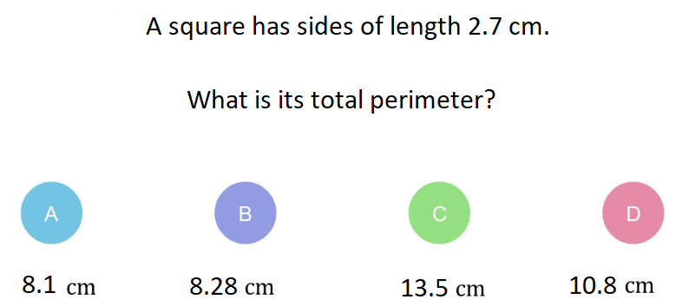
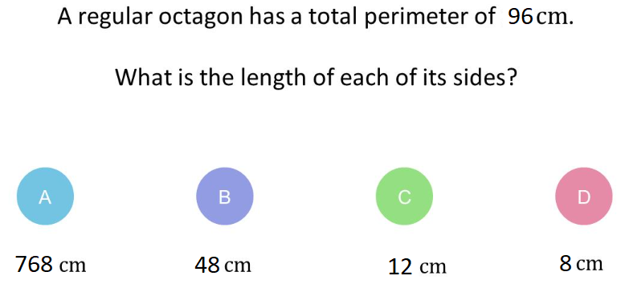
6. a) An equilateral triangle has perimeter 12 m. Find the side length of one of its sides.
b) A square has perimeter 48 cm. Find the side length of one of its sides in cm.
Shown is an equilateral triangle with side length of 8cm. Six of the triangles are put together to make a larger shape. Find the perimeter of the larger shape.
4m
12cm
48cm
Skills Check
1. 2.
3. 4.

